Slide 1

Project Proposal
On
Title:Password Generator
Presented by
Innovative Group
(Payal,Palak,Prabhat Kumar)
Under the supervision
of
Dr.Amandeep Kaur (Professor)
Chitkara University Institute of Engineering and
Technology (CUIET)
Chitkara University, Punjab

Slide 2
PASSWORD
GENERATOR

Slide 3
INTRODUCTION
What does Password Generator mean?
A password generator is a software tool that creates random or customized passwords for users.
These programs produce complex/strong passwords with combinations of numbers, uppercase and lowercase letters, and special characters such as braces, asterisks, slashes, etc.
What is the use of Password Generator?
It helps users create stronger passwords that provide greater security for a given type of access.
Nowadays security is everything so, It creates strong password and make your accounts difficult to hack.

Slide 4
Motivation
According to the data’s there are around 2,200 cyberattacks being done by hackers every day all over the world and 800,000 people being hacked every year.And Major cause of these attacks is less secure passwords.

Slide 5
Outcomes:
The objective of this project to generate secure passwords for the users to make their account more difficult to be hacked.
This makes their account more secure.

Slide 6
Justification
The project will helps the user to generate the secure password for their various accounts.

Slide 7
Methodology
WE FOLLOWED CERTAIN STEPS TO BUILD THE PROJECT:
First we import the random module.
Then we ask user for no of letters, symbols and numbers he or she wants for the password.
The we generate the password and show it to the user.

Slide 8
Work plan
The longer is password ,the more secure it is. A strong password should be at least 12 characters long.
Strong passwords use a combination of letters,numbers,cases and symbols to form an unpredictable string characters that doesn’t resemble words or names.
A strong password should be unique to each account to reduce vulnerability in the event of a hack.

Slide 9
References
Reference always play an important role in Recreating something from the scratch,
For this project we take reference from the tutor at Udemy Dr.Angela Yu (The Complete Python Bootcamp 2022 Course).
Dr.Angela Yu is a Developer and lead instructor at The App Brewery .

Slide 10
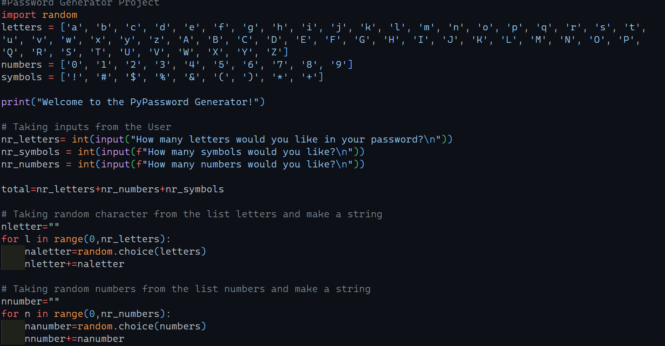

Slide 11
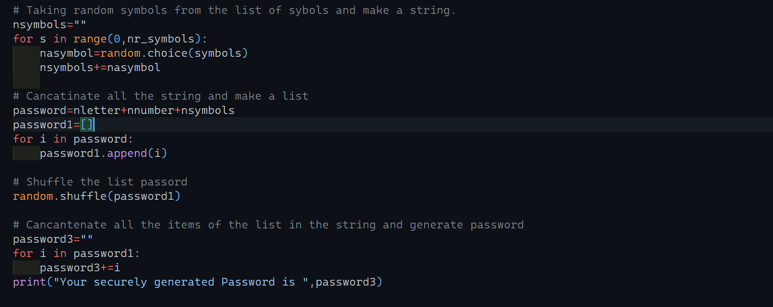

Slide 12
Thank you

